Slide 1
Major League Baseball Analysis
Project Team: Ian Morrison, Jacob Pos, Johnny Capra, Laura Dudley

Slide 2
Insights from over a century of games
Since baseball's beginning as a professional sport nearly 150 years ago, people have been recording meticulous details about each game.
We are exploring a dataset of over 100 Major League Baseball (MLB) seasons to discover what broader trends and relationships can be found with such a long period of game records.
Questions:
1) Is there really such thing as a "home team advantage"?
2) What are the differences in how teams with the most playoff games score vs. the teams with the fewest playoff games?
3) Do global or economic events affect the number of games played in a season, and if so, in what way?
Notes:
Since baseball's beginning as a professional sport nearly 150 years ago, people have been recording meticulous details about each game in order to rank teams and quantify the performance of individual players.
Since individual player statistics are broadly available, we decided to focus our analysis on the teams instead.
We are exploring a dataset of over 100 Major League Baseball (MLB) seasons to discover what broader trends and relationships can be found with such a long period of game records.
1) Is there really such thing as a "home team advantage"? In other words, is a team more likely to win if playing at their home stadium? Is there any difference between how likely a team will win in the regular season vs. the playoffs in their home stadium?
2) What are the differences in how teams with the most playoff games score vs. the teams with the fewest playoff games?
3) Do global or economic events affect the number of games played in a season, and if so, in what way?

Slide 3

Exploring Home Team Advantage
Notes:
The first question we examined is whether a team really has an advantage when playing in their home stadium, aka the “home team advantage.”
The phrase is pretty common in our language, but is it just observation bias by excited fans watching their home team play?
We looked at this question in two ways, using the scores for every game played each season from 1910 through 2019.

Slide 4
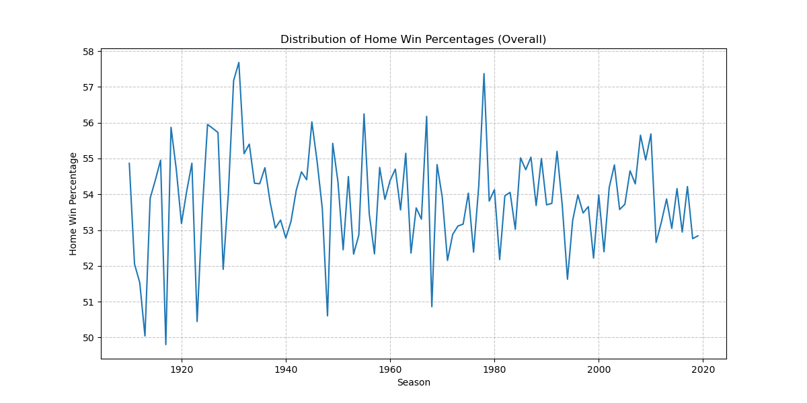
Exploring Home Team Advantage
Notes:
By calculating the percentage of games won by home teams in each season (regular season & playoff games) and plotting it as a line graph, we were able to see that the percentage of home team wins was over 50% for every year except 1917.

Slide 5
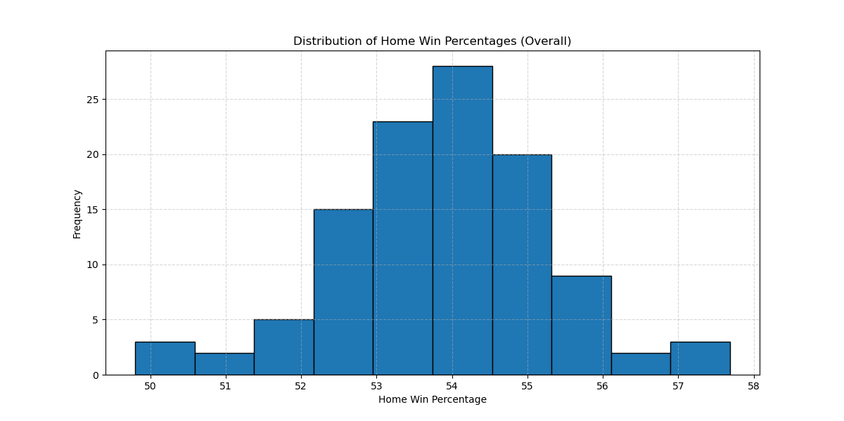
Exploring Home Team Advantage
Notes:
We then created a histogram to display the frequency of each home win percentage in our dataset. As you can see from this visualization, the majority of home team win percentages for all years is between just over 52% and just over 55%.

Slide 6
Exploring Home Team Advantage
Notes:
This indicates a slight but noticeable advantage to the home team. Looking back at the line graph, we can see that the past 40 years of games has consistently stayed within these values, while earlier seasons account for some of outlying, less frequent values (49%-50% and 56%-57%).

Slide 7
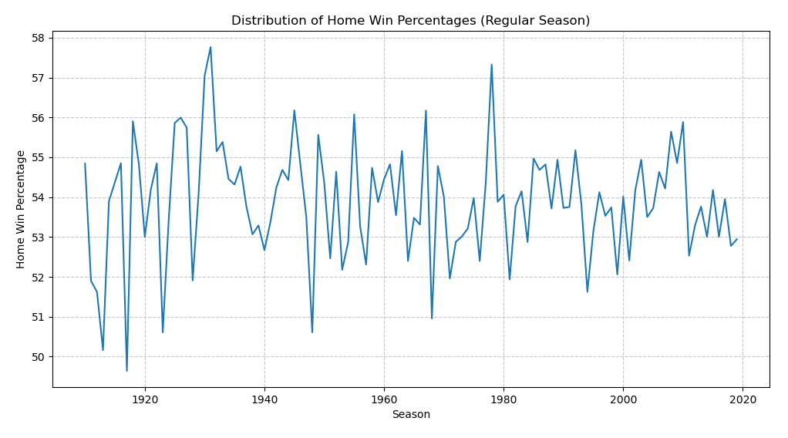
Exploring Home Team Advantage: Regular Season Only
Notes:
The next 4 visualizations were created the same way, but specifically for regular season home team wins and playoff home team wins.

Slide 8
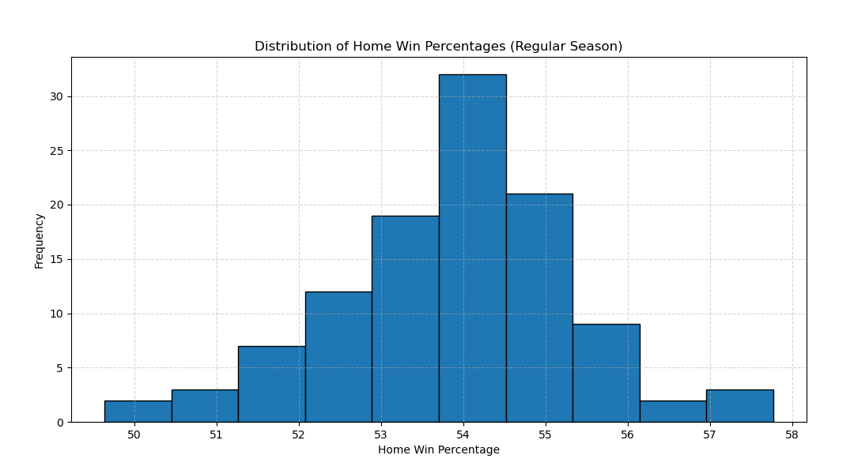
Exploring Home Team Advantage: Regular Season Only
Notes:
As you can see, the regular season very closely follows the previous visualizations of the overall home team wins, which is to be expected because the majority of games are played during the regular season.

Slide 9
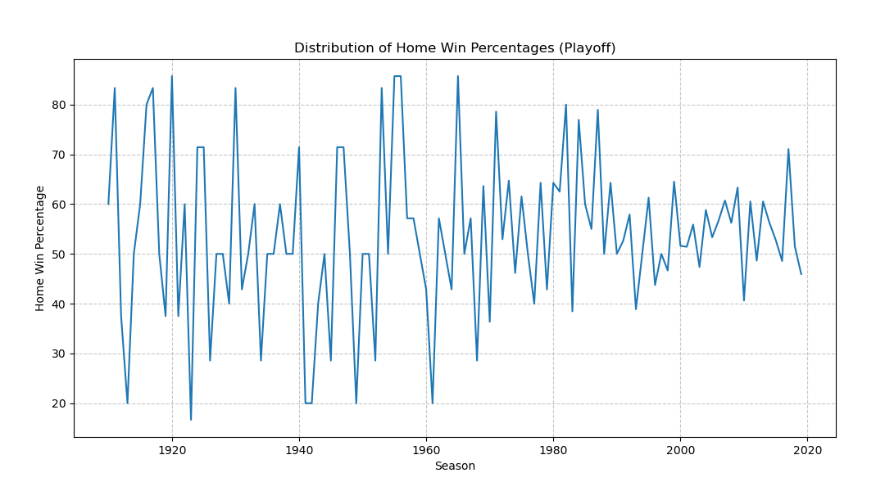
Exploring Home Team Advantage: Playoff Games
Notes:
There is greater variability in the home team wins for the playoffs…

Slide 10
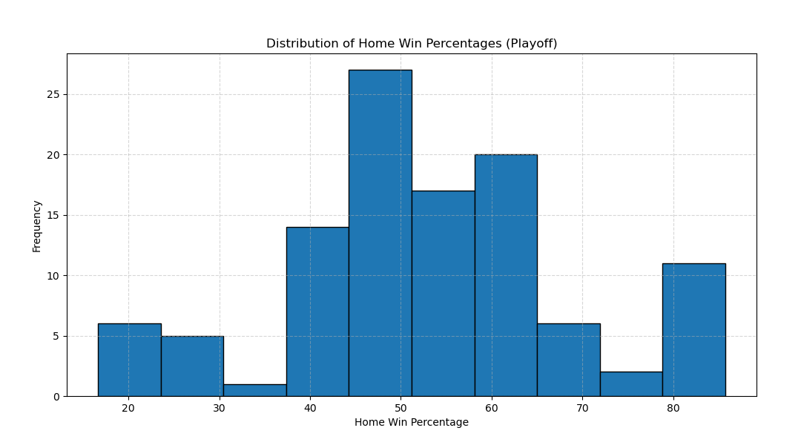
Exploring Home Team Advantage: Playoff Games
Notes:
…with the most frequent total home team win percentages hovering around 50%, plus or minus a few tenths of a percent. This greater variability is most likely due to the smaller dataset, as relatively few playoff games are played in a season.

Slide 11
Home Team Advantage Conclusions
Notes:
Based on these visualizations, we can conclude that the idea of a “home team advantage” holds true as an observation for most games played, but not during the playoffs.

Slide 12
Playoff Score Distribution: Top 5 Teams vs. Bottom 5 Teams
Notes:
Our next question compares the scores from teams that have been played many playoff games against the scores from teams that have played in only a few playoff games, to see if there is a pattern or a visible difference in these two groups.
We first determined the top 5 and bottom 5 playoff teams by counting the number of playoff games played from 1910 through 2019 and selecting the highest and lowest counts, respectively.
Next, we created a box plot of each team’s score distribution, grouped into the top 5 teams and the bottom 5 teams.

Slide 13
Brief Explanation on Playoff Games
Two conferences : National League & American League
Each conference has 3 divisions
Each division has 5 teams
6 teams per conference are sent to the playoffs
Notes:
Once the regular season has concluded, each team will have played 162 games. Since there are 30 teams in the league, this equates to 2,430 games played. From there the top six teams from each conference with the best record will advance to the playoffs. This used to be the top five teams from each conference, but this was expanded starting in 2022. The two conferences are the National and American League conferences. They both have three divisions within their conferences, six in total. A central, east and west division. Each division has 5 teams. In the playoffs there are three division winners from each conference as well as three wild card teams from each conference. 12 total. The wild card teams are teams that had the second-best records in their divisions. They used to play in a wild card game which mean that it was a single elimination do or die game in order to advance. This was the method from 2012 to 2021 but as of 2022 this has been changed to a best of three game series. This means the first team to win two games out of the three advances on to the next round to face the division winners. The two division winners with best records in the each of their respective conferences will receive first round byes. This means they do not have to compete in the first round of the playoffs. They will play the winners of the first round in the second round. This is their reward for having great records in the regular season. These division round playoff games will be a best of five series, aka first team to win three games. These games will be a 2-2-1 format meaning the team with the better record will have the first two games at home and the last final game should it come to it. The championship round for each conference. The final two teams remaining in both conferences will be in a best of seven series, aka first to win five games in a 2-3-2 format. The same will be for the world series when the final team from both conferences play for the league championship.

Slide 14
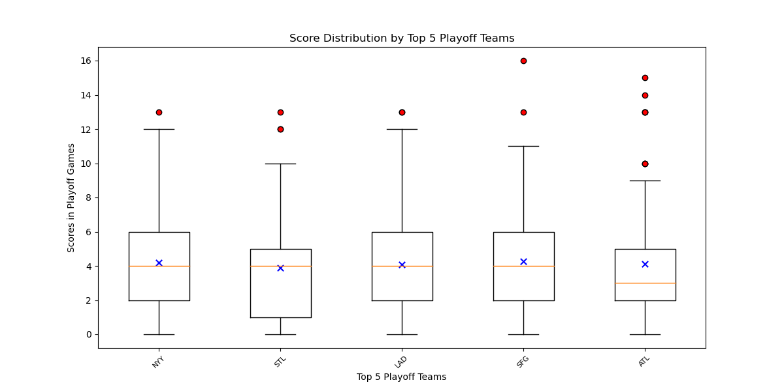
Playoff Score Distribution
Notes:
These box plots display the following statistical information about each team’s playoff scores:
-The mean (average) score, represented by the “x” in the box.
-The median score, shown as a horizontal bar inside the box.
-The upper and lower quartiles (75th percentile & 25th percentile) of their scores, displayed as the top and bottom of the box. The distance between the box’s top & bottom reflects the statistical dispersion (interquartile range) of the scores.
-The minimum and maximum values within 1.5 times the statistical dispersion, shown as vertical lines (whiskers) coming out of the box.
-Any outlier scores, which are scores outside the minimum and maximum values calculated above. These are represented by red dots on our visualizations.

Slide 15
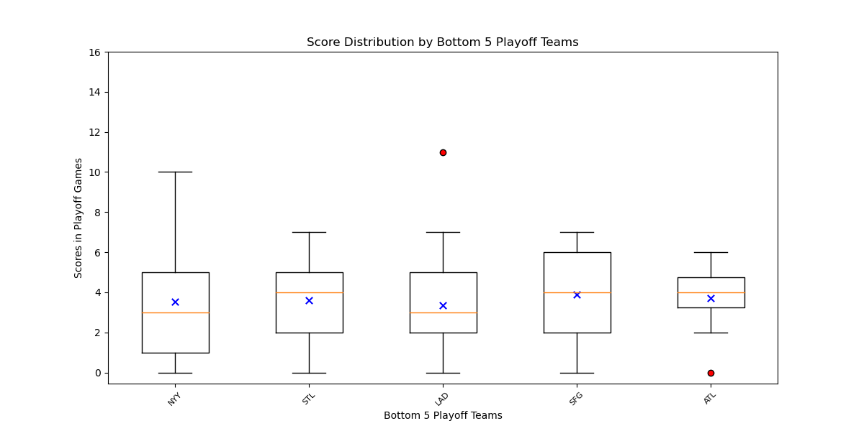
Playoff Score Distribution
Notes:
The notable differences between the top 5 teams’ box plot and the bottom 5 teams’ box plot are the box sizes and the number of outlier scores.

Slide 16
Playoff Score Distribution
Notes:
The top 5 teams have very similar sized boxes in the box plot, which would indicate a similar degree of variability between these teams in their playoff game scores. The top 5 teams also each have at least one outlier score above the maximum value, which don’t fit the typical pattern of scores. Together these seem to indicate a common trait of these teams is both a consistent and competitive ability to score high in their playoff games.

Slide 17
Playoff Score Distribution
Notes:
The bottom 5 teams have less consistent boxes, and only have a single outlier score above the maximum value and a single outlier low score.
The maximum values indicated by the top whiskers are also lower in general than the maximum values of the top 5 teams.
Together, this seems to indicate a lower scoring ability for these teams.

Slide 18
Playoff Score Distribution: Conclusions
Notes:
There are number of factors that could influence the chances of a team winning or cause a team to score less runs than their opponent. This can only best be described as dumb luck or pure chance. An aligning of the stars. Teams are full of induvial players all playing a specific role in their team to try and help them win as a unit. We found that no one position, or individual will indicate a team’s higher probability to win a game let alone a series. It comes down to random chance. From a team hitting better than the team they are facing, or a team hitting extremely well, significantly above average but the off chance the team they’re playing is hitting just slightly better or is able to produce plays that nullify the hitting. To teams pitching better or worse. Injuries to best hitters, pitchers, outfielders. Poor strategy and game play. Decisions to steal bases. Abilities to catch players stealing bases. Even down to fan and or weather interference. Players and teams go through hot streaks and cold streaks. They deal with trades, chemistry issues, injuries, superstitions, and all the pressures that come with being expected to win. It is incredibly rare that the best team in baseball actually wins the championship.

Slide 19
Factors Impacting Games Played
Notes:
Our final question was inspired while exploring a second data source. This API had data from fewer years, but also went more current than our primary dataset.

Slide 20
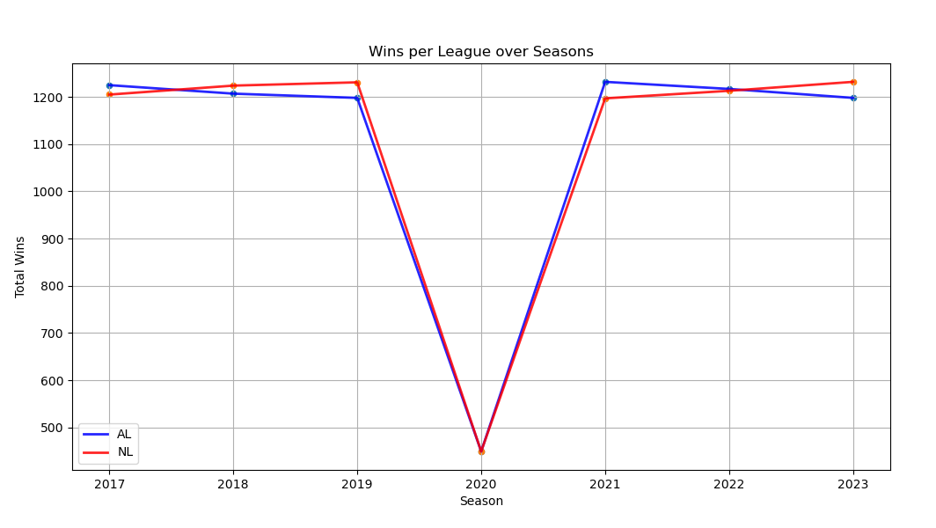
Total Wins per League from 2017-2023
Notes:
Major League Baseball comprises two leagues – the National League (NL) and the American League (AL). This line graph compares the number of total wins for each league for the 2017 to 2023 seasons. As you can see, the leagues are very closely matched, however the dip in the number of wins for both leagues in 2020 is quite dramatic. Due to the COVID-19 pandemic, the 2020 season had fewer than half of the total games originally scheduled for the season, which lead us to wonder what other events may have affected baseball throughout its long history as a professional sport.

Slide 21
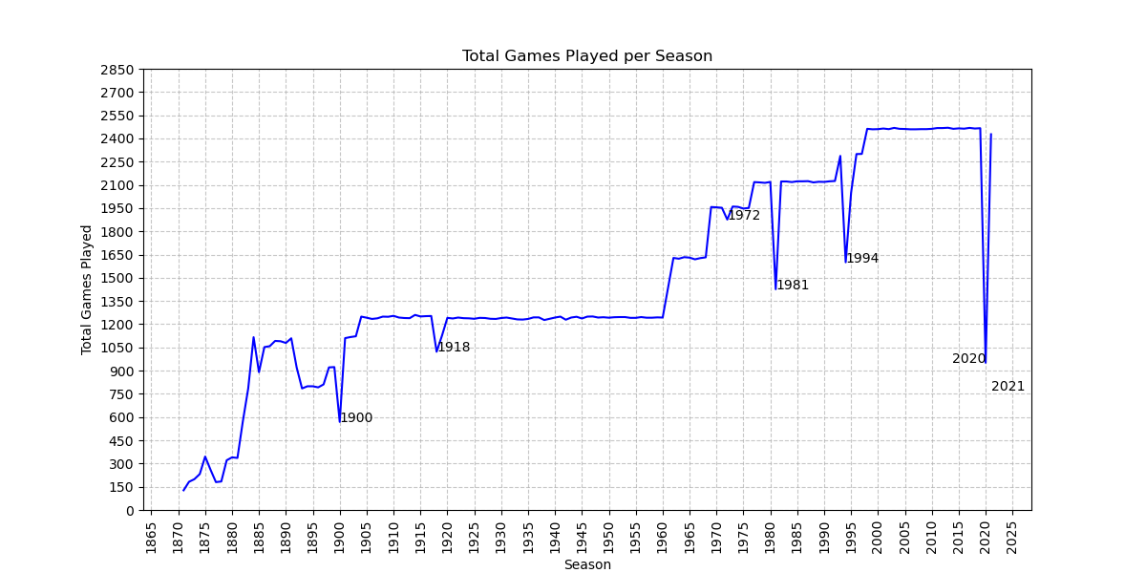
Total Games per Season: 1871 to 2021
Notes:
Returning to our primary dataset, we created a line graph showing the total number of games played each season, starting with the earliest (1871) through the latest (2021) in this dataset. The resulting visualization reveals several other seasons in which significantly fewer games were played.
There’s quite a bit of variability in the number of games played during the first three decades, which can be attributed to the infancy of the sport’s organization, however the trend is an increase in the number of games per season over time.

Slide 22
First Notable Decreases: 1900 & 1918
Notes:
Then we get to the first dramatic dip in our graph, 1900. This marks the end of the early history of baseball in America, in which there were multiple leagues, to the two-league system (NL & AL) we have now, established in 1901.
The number of games played in a season during the period of 1904 to 1960 is incredibly stable, with just one dip during 1918. Initially, we believed this to be an effect of the 1918 Influenza pandemic (so-called “Spanish Flu”), but it was actually World War I. The “Work or Fight” rule, issued in 1918, required men to either work in jobs supporting the war effort, or be drafted. As the deadline for compliance was mid-season (July), the MLB requested and was granted an extension, with the agreement that the season would be shortened.

Slide 23
Player Strikes: 1972, 1981 & 1994
Notes:
Following this stable period, the number of games trends upward again until 1972, when we see another dip, which was caused by a player strike. The strike continued past the season’s start date, causing the first 1 ½ weeks’ games to be cancelled.
Another player strike in 1981 caused an even more dramatic dip in the number of games played during that season. Unlike the 1972 player strike, which lasted a little under 2 weeks at the beginning of the season, the 1981 player strike continued for 2 months in the middle of the season. This led to approximately 38% of the season’s games being cancelled.
Yet another player strike occurred in 1994, which was the longest strike in MLB history and caused the 1994 regular season to be ended early and the cancelation of the World Series for that year.

Slide 24
COVID-19 Disruptions: 2020
Notes:
The final and most dramatic dip was, of course, in 2020, and the height of the COVID-19 pandemic. Indefinite postponements, positive test results in players, and restrictions on travel and gathering all contributed to the drop in 2020’s total games by approximately 2/3rds the normal count.

Slide 25
Conclusions
Notes:
Despite the effects of a war, multiple player strikes, and global pandemic reflected in this visualization, it’s notable that many other national and global crises happened during this period of over 150 years which didn’t affect the baseball season at all, at least in terms of the number of games played.

